Slide 1

2018 Seminar on Predictive Modeling: Machine Learning Models using R
Jeffrey Strickland, Ph.D., CMSP, ASEP
CEO Humalytica Analytics

Slide 2

The Imitation Game

Slide 3
Crime Linkage by Similarity
Hierarchical clustering is an algorithmic approach to crime series cluster analysis that sequentially forms a hierarchy of cluster solutions.
The agglomerative approach starts with every observation (e.g., crime incident) in its own cluster.
Then it sequentially merges the two closest clusters to form a new larger cluster.
This process is repeated until all observations are in the same cluster or a stopping criterion is met.

Slide 4
crimelinkage R-Package
The crimelinkage package provides the function crimeClust_hier() for agglomerative hierarchical crime clustering
It uses the log Bayes factor as the pairwise similarity measure
That is, the similarity between crimes i and j is the estimated Bayes factor for linkage

Slide 5
Clustering Unsolved Crimes
In this example, we will cluster all of the unsolved crimes from crimes data and display dendrogram of results with plot_hcc() function.
#-- Get unsolved crimes
unsolved = subset(crimes, !crimeID %in% seriesData$crimeID)
#-- Run agglomerative hierarchical crime clustering
tree = crimeClust_hier(unsolved,varlist,estimateBF,
linkage='average’,
binary=TRUE)
#-- Plot results in dendrogram using plot_hcc()
plot_hcc(tree,yticks=seq(-2,6,by=2),type="triangle",hang=.05,
main="Average Linkage")

Slide 6
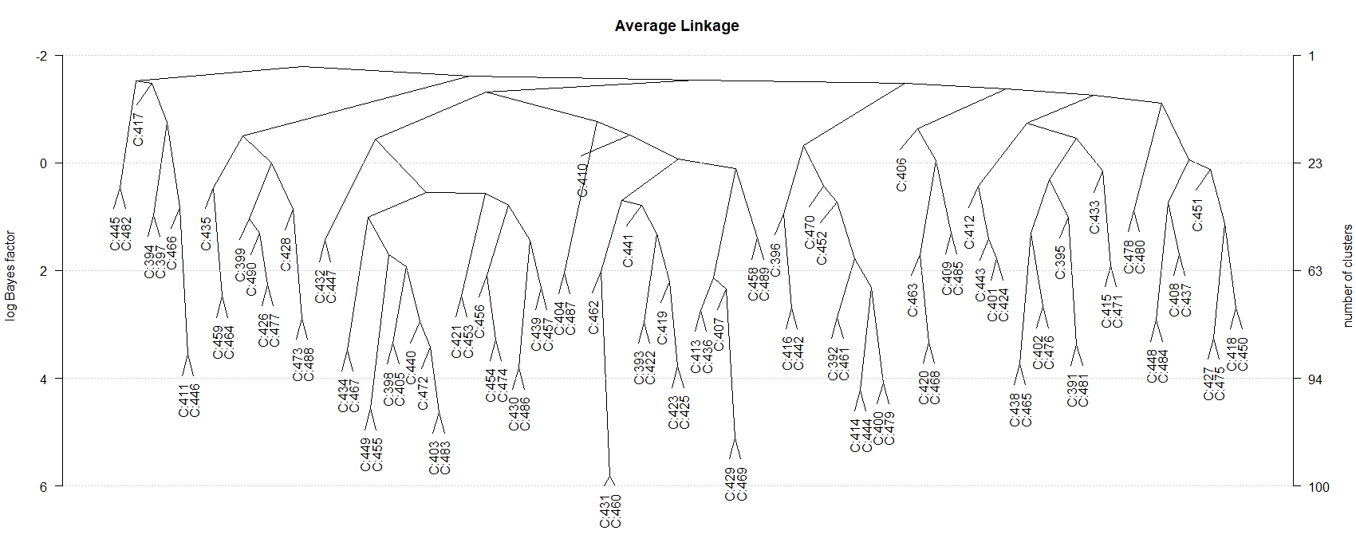
Dendrogram using Average Linkking
The dendrogram (using average linkage) merges 5 crime pairs with a log Bayes factor of more than 4.

Slide 7
Examine Crimes C:431 and C:460
> subset(crimes,crimeID %in% c('C:431','C:460'))
Examining the crimes C:431 and C:460 (which were the most similar), we can see they are close in space, around 2 weeks apart in time, and have matching values for MO1, MO2, and Mo3.
crimeID X Y MO1 MO2 MO3 DT.FROM DT.TO
431 C:431 7097.0 -10256.8 26 a D 1993-10-23 22:00:00 1993-10-24 06:00:00
460 C:460 7195.3 -10624.8 26 a D 1993-11-07 03:10:00 1993-11-07 03:10:00

Slide 8
ClusterPath
If there is a particular crime of interest, then the function clusterPath() will find the sequence of merges and scores for the event.
This shows that crime C:429 first get grouped with crime C:469 with a log Bayes factor of 4.82. Then this pair gets grouped with C:413, C:436 with an average log Bayes factor of 2.13.
> cp = clusterPath('C:429',tree)
> # only return path for scores > 0
> cp[cp$logBF > 0,]
logBF crimes
1 5.1074735 C:469
2 2.3400814 C:407
3 2.1364088 C:413, C:436
4 0.1009954 C:458, C:489

Slide 9
Hierarchical Based Crime Series Linkage
This approach to crime series identification compares an unsolved crime to every crime in criminal incident database and calculates its similarity as the log Bayes factor (according to the model developed for case linkage).
Then it aggregates the similarity scores over the crime groups using single, complete, or average linkage.
Single linkage uses the largest score (most similar crime) from each group
Complete linkage uses the smallest score (least similar crime) from each group
Average linkage uses the average score as the group score.

Slide 10
Example
To give an example, extract the solved and unsolved crimes from the crimes data.
solved = subset(crimes, crimeID %in% seriesData$crimeID)
unsolved = subset(crimes, !crimeID %in% seriesData$crimeID)

Slide 11
Second Unsolved Crime – c:392
The function seriesID() can be used to find the most similar crime series to the unsolved crime.
> crime = unsolved[2,]
> # use the 2nd unsolved crime C:392
> crime
crimeID X Y MO1 MO2 MO3 DT.FROM DT.TO
392 C:392 12793.2 -3386.5 25 a E 1993-06-19 07:00:00 1993-06-19 07:00:00

Slide 12
Score Results
> results = seriesID(crime,
solved,
seriesData,
varlist,
estimateBF)
> head(results$score)
group average single complete
1 12 3.739680 3.739680 3.739680
2 154 3.637851 3.637851 3.637851
3 160 3.617055 3.617055 3.617055
4 8 3.494182 3.494182 3.494182
5 9 3.224453 3.924757 2.760956
6 10 3.224453 3.924757 2.760956
This shows that the unsolved crime is most similar to the crime(s) in crime group 12 with an average linkage log Bayes factor of 3.73968

Slide 13
Naïve Bayes (NB) Spatial Variables (X , Y) Analysis
> NB$spatial
from to value(X,Y) N.linked N.unlinked p.linked p.unlinked BF
1 0.000000 1.330002 [0.00,1.33] 18.92490842 408 0.39386082 0.05777996 6.8165648
2 1.330002 2.236050 (1.33,2.24] 2.58791209 515 0.07441269 0.06668887 1.1158187
3 2.236050 3.111460 (2.24,3.11] 2.35531136 519 0.06986449 0.06702191 1.0424127
4 3.111460 3.854694 (3.11,3.85] 0.57765568 522 0.03510481 0.06727170 0.5218362
5 3.854694 4.568613 (3.85,4.57] 2.47692308 516 0.07224245 0.06677213 1.0819251
6 4.568613 5.365327 (4.57,5.37] 1.87765568 520 0.06052457 0.06710517 0.9019360
7 5.365327 6.126928 (5.37,6.13] 0.35714286 521 0.03079298 0.06718843 0.4583077
8 6.126928 6.918310 (6.13,6.92] 1.16666667 525 0.04662213 0.06752148 0.6904785
9 6.918310 7.728588 (6.92,7.73] 0.04761905 526 0.02474065 0.06760474 0.3659603
10 7.728588 8.575494 (7.73,8.58] 0.00000000 526 0.02380952 0.06760474 0.3521872
11 8.575494 9.461998 (8.58,9.46] 1.04761905 525 0.04429431 0.06752148 0.6560033
12 9.461998 10.631034 (9.46,10.6] 0.19047619 523 0.02753403 0.06735496 0.4087900
13 10.631034 12.286147 (10.6,12.3] 0.00000000 526 0.02380952 0.06760474 0.3521872
14 12.286147 14.616999 (12.3,14.6] 0.00000000 527 0.02380952 0.06768800 0.3517540
15 14.616999 22.931787 (14.6,22.9] 1.26666667 522 0.04857750 0.06727170 0.7221090

Slide 14
Associated Crimes and Offenders
To get the crimes and offenders associated with these groups, just use the subset() function with the groups object:
> subset(results$groups,group=='12’)
> # most similar crime series
> subset(results$groups,group=='154')
> # 2nd most similar series
crimeID Index CS offenderID TIME group
27 C:148 148 12 O:109 1993-06-25 01:20:00 12
crimeID Index CS offenderID TIME group
205 C:304 304 154 O:237 1993-10-25 07:00:00 154

Slide 15
A series with multiple crimes
> subset(results$groups,group=='9')
crimeID Index CS offenderID TIME group
9 C:144 144 9 O:106 1993-06-20 03:27:00 9
10 C:163 163 9 O:106 1993-06-20 13:15:00 9
11 C:145 145 9 O:106 1993-06-20 01:30:00 9
12 C:164 164 9 O:106 1993-06-20 13:15:00 9
13 C:165 165 9 O:106 1993-06-20 12:45:00 9
14 C:166 166 9 O:106 1993-06-20 12:45:00 9

Slide 16
The 4th unsolved crime
We can do this for another unsolved crime
log Bayes factors are around 1, so this unsolved crime is not very similar to any other solved crimes in the crime database
Perhaps this is the start of a new crime series?
crime4 = unsolved[4,]
results4 = seriesID(crime4,solved,
seriesData,varlist,estimateBF)
head(results4$score)
group average single complete
1 136 1.5283543 1.5283543 1.5283543
2 316 1.1363833 1.1363833 1.1363833
3 37 0.8748010 0.8748010 0.8748010
4 48 0.8748010 0.8748010 0.8748010
5 206 0.5522861 0.5522861 0.5522861
6 219 0.4631613 0.4631613 0.4631613

Slide 17
Crime C:394 (the 4th unsolved crime)
It is also possible to compare a crime to all unsolved crimes to detect potential unsolved crime series
pairs = data.frame(i1=unsolved$crimeID[4]
i2=unique(unsolved$crimeID[-4]))
X = compareCrimes(pairs,unsolved,
varlist,binary=TRUE) # Evidence data
score = data.frame(pairs,logBF=estimateBF(X))
head(score[order(-score$logBF),])
There are no unsolved crimes that are very similar to this one - probably not enough evidence to link this crime to any others.
i1 i2 logBF
6 C:394 C:397 0.980062532
79 C:394 C:470 0.752385770
5 C:394 C:396 0.339529086
60 C:394 C:451 -0.007776621
69 C:394 C:460 -0.186420669
47 C:394 C:438 -0.206162572

Slide 18
Comparison
This approach also gives similar results to what was obtained from the hierarchical clustering path approach:
C429 = which(unsolved$crimeID %in% 'C:429')
pairs = data.frame(i1=unsolved$crimeID[C429],
i2=unique(unsolved$crimeID[-C429]))
X = compareCrimes(pairs,unsolved,
varlist,binary=TRUE) # Evidence data
score = data.frame(pairs,logBF=estimateBF(X))
head(score[order(-score$logBF),])
i1 i2 logBF
78 C:429 C:469 5.107474
17 C:429 C:407 2.735772
23 C:429 C:413 2.371051
45 C:429 C:436 2.287908
13 C:429 C:403 1.305843
C:429 C:393 1.261425
results from hierarchical clustering
logBF crimes
1 4.8226300 C:469
2 2.1332281 C:413, C:436
3 0.1540873 C:407, C:433

Slide 19
Partially-supervised Bayesian model
This approach is partially-supervised because
the offender is known for a subset of the events
utilizes spatiotemporal crime locations
uses crime features describing the offender's modus operandi.
The hierarchical model naturally handles complex features often seen in crime data, including :
missing data
interval censored event times
a mix of discrete and continuous variables.
Provides uncertainty assessments for all model parameters, including the relative influence of each feature (space, time, method of entry, etc.)
The model produces posterior clustering probabilities which allow analysts to act on model output only as warranted

Slide 20
Make the crime group labels for each crime
seriesData$CG = makeGroups(seriesData,method=2)
# method=2 uses unique co-offenders
group_info = unique(seriesData[,c('crimeID','CG')])
# extract the group info
A = merge(crimes,group_info,by="crimeID",all.x=TRUE)
# add group info to crimes
A = A[order(A$CG),] # order by crime group

Slide 21
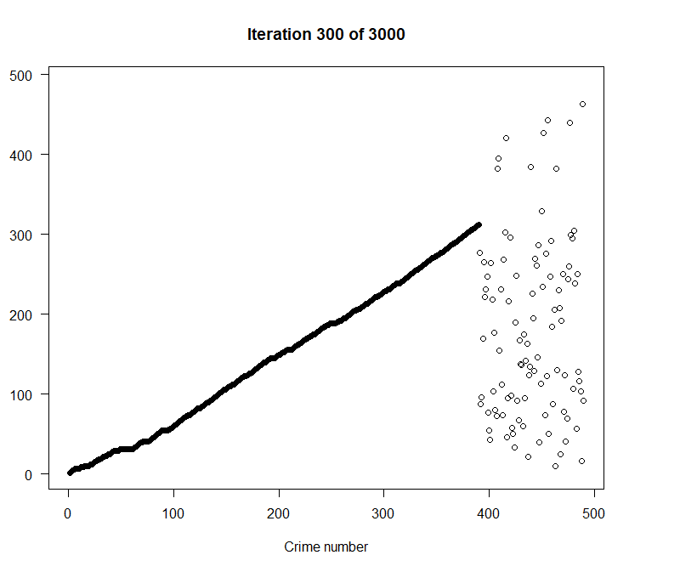
Partially-supervised Bayesian model
The function crimeClust_bayes() is used for the Bayesian model-based clustering approach
The matrix pp contains the pairwise estimated probability that two crime are linked (share a common offender).
We can use this information for crime series identification.
fit = crimeClust_bayes(A$CG, spatial=
A[,c('X','Y')],t1=A$DT.FROM,
t2=A$DT.TO,
Xcat=A[,c("MO1","MO2","MO3")],
maxcriminals=1000,
iters=3000,burn=1000,
update=100,seed=5)

Slide 22
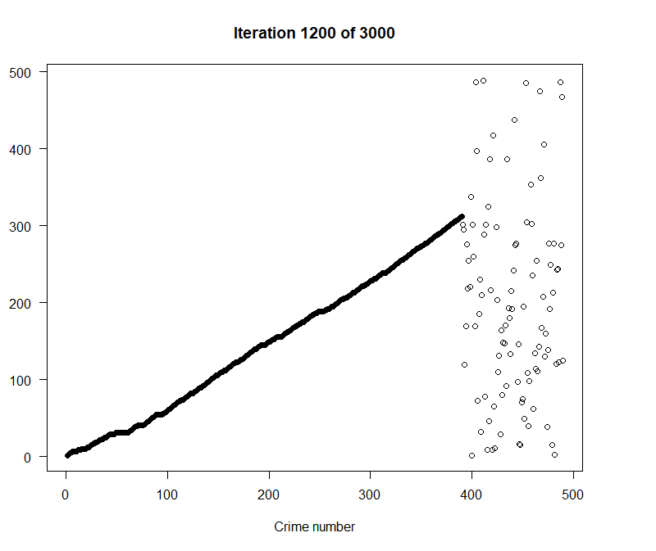
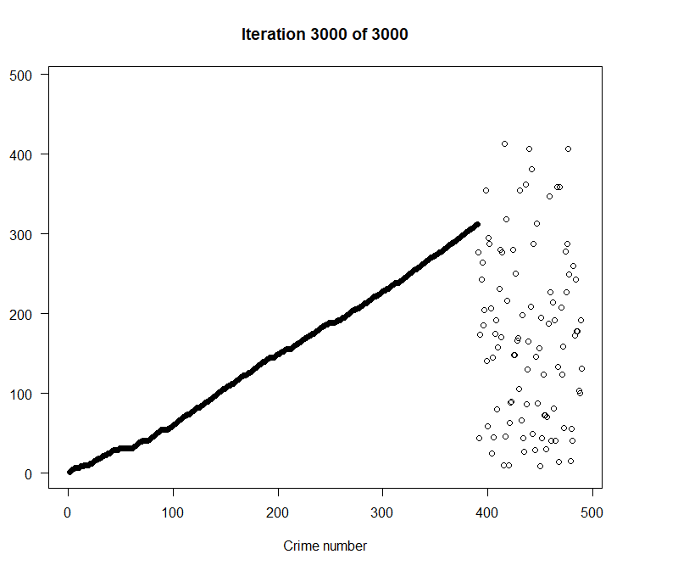
Partially-supervised Bayesian model

Slide 23
Results
Using the image.plot() from the fields package, we can see how strongly the unsolved crimes are linked to the existing (solved) crime series

Slide 24
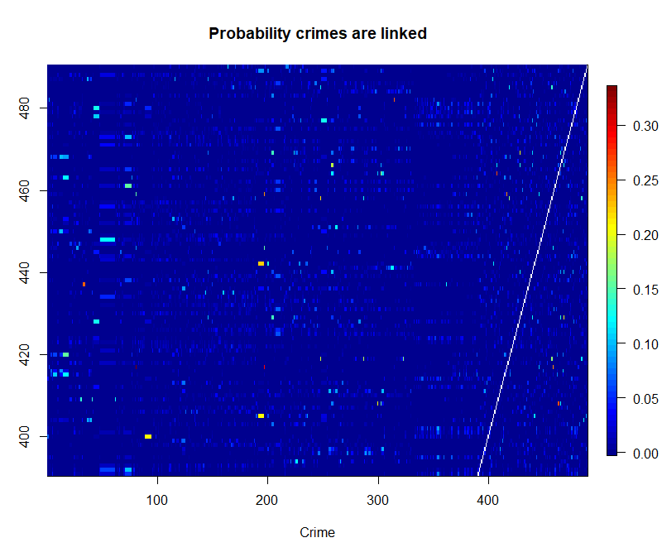
Probability Crimes are linked
Using the image.plot() from the fields package, we can see how strongly the unsolved crimes are linked to the existing (solved) crime series.
library(fields)
#-- Get index of unsolved crimes
ind.unsolved = which(is.na(A$CG))
# index of unsolved crimes
n = nrow(A)
# number of crimes
#-- Image plot of linkage probabilities
fields::image.plot(1:n,ind.unsolved,
pp[1:n,ind.unsolved],
xlab="Crime",ylab="Unsolved Crime",
main="Probability crimes are linked")
We see that some unsolved crimes are linked to solved crimes with a posterior probability above 0.25. These crimes may be worth further investigations.

Slide 25
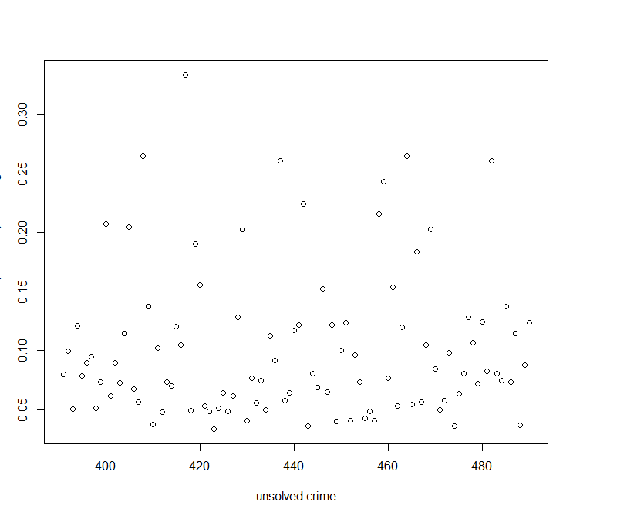
Maximum posterior probability
Here we plot the maximum posterior probability that an unsolved crime is linked to another crime (solved or unsolved)
unsolved.probs = apply(pp[ind.unsolved,],1,max,na.rm=TRUE) # maximum probability
plot(ind.unsolved,unsolved.probs,
xlab="unsolved crime",
ylab='maximum probability of linkage')
abline(h=0.25)

Slide 26
Investigate crimeIDs for crimes with strongest linkage
This shows that C:408, C:417, C:464 are the crimes with the strongest linkages (posterior probabilities greater that 0.25).
ind = ind.unsolved[unsolved.probs > 0.25]
investigate = as.character(A$crimeID[ind])
Investigate
[1] "C:408" "C:417" "C:437" "C:464" "C:482“

Slide 27
Conclusions: crimes with strongest linkage
A particular crime can be investigated in more detail with the function bayesProb():
bp = bayesProb(pp[A$crimeID %in% "C:417"])
bp$crimeID = A$crimeID[bp$index]
bp$CG = A$CG[bp$index]
head(bp)
index prob crimeID CG
1 81 0.3335 C:15 46
2 197 0.2920 C:26 146
3 459 0.2415 C:459 NA
4 446 0.0985 C:446 NA
5 2 0.0510 C:10 2
6 482 0.0400 C:482 NA
For this example, our model provides a list of the most likely crimes associated with the unsolved crime C:417.
The first two crimes (C:15 and C:26) are solved crimes indicating that the offender(s) responsible for these crimes may also be responsible for C:417.
The next two crimes, C:459 and C:446 do not have a group ID.
This means that they are unsolved crimes.
By providing the posterior probabilities, crime analysts may choose to investigate further only if the linkage is strong enough.

Slide 28
www.humalytica.com
http://www.amazon.com/Jeffrey-Strickland/e/B00IQ69QZK/
http://www.lulu.com/spotlight/strickland_jeffrey

